Slide 1
HoloCam: Low-power wide-field incoherent target detector
Prasanna Pavani, Jonathan Hull, Sergey Chemishkian, Kathrin Berkner, Ken Gudan
6/24/2012
Notes:
My name is Prasanna Pavani. I am with Ricoh Innovations in Menlo Park CA. In this talk, I will be introducing HoloCam, which is a target detector that exploits a new sensing paradigm that we call distribution sensitivity to achieve low-power and high-speed operation
Todo:
1. Verify 50cm range

Slide 2
Low-power target detection
Detect target presence/absence with
Low power (µW)
High speed (KHz)
Wide field (50˚)
Compact size (cm³)
Room light
Applications
Automotive, Factory Automation, Consumer Electronics
Is target present?
Yes
Low-power target detector
Action
Target
No
Notes:
Our goal is to design a target detector that generates a binary output to indicate the presence or absence of a target. And we’d like the target detector to consume very power, in the order of uW, operate at high speeds (at least khz),
Need for constant monitoring - Always on (sergey)

Slide 3
Low-power target detection: Digital Processing
Detect target presence/absence with
Low power (µW)
High speed (KHz)
Wide field (50˚)
Compact size (cm³)
Room light
Applications
Automotive, Factory Automation, Consumer Electronics
Is target present?
Yes
Camera
Image Processing
Action
Target
No
Digital Processing: High power (mW), Low speed (30Hz)
J. A. Ratches, Opt. Eng. 50 (2011)
Notes:
Camera + image processing consumes power
Optical correlator: laser, alignment sensitive, needs image processing

Slide 4
Low-power target detection: Optical Correlator
Detect target presence/absence with
Low power (µW)
High speed (KHz)
Wide field (50˚)
Compact size (cm³)
Room light
Applications
Automotive, Factory Automation, Consumer Electronics
Is target present?
Yes
Optical
Correlator
Action
Target
No
Optical Correlator: Bulky, Alignment sensitive, Lasers
J. D. Armitage et al., Appl. Optics 4, 461 (1965)
Avi Pe’er et al., Optics Letters 24, 1469 (1999)
Pierre Ambs, Adv. in Opt. Tech., 372652 (2010)
Notes:
Camera + image processing consumes power
Optical correlator: laser, alignment sensitive, needs image processing

Slide 5
HoloCam: Low-power target detector
Target Hologram
Encodes target features
Single-element optical processing
Distribution Sensitive Detector
Single-pixel spot/blur classifier
Local-currents in non-uniform illumination
Features
Low power (<20µW)
High speed (2.5KHz)
Wide field, Compact, Room light
Distribution Sensitive Detector (DSD)
Target
Hologram
Target
$$h(t)$$
$$a(t)$$
Ambient-light Detector
Notes:
Talk about Ambient Light Detector (for normalizing illumination variations)

Slide 6
Target Hologram Design
Computer Generated Hologram Optimization
Wavefront control: projections on to convex sets
Piestun et al., Opt. Lett. 19, 771 (1994)
Initial Estimate: Matched Filter
Hologram plane constraint: Phase-only
Detector plane constraint: Confine intensity to tight spot
Detector
Initial Estimate
Target Hologram Constraint (H)
Detector Constraint
Spot size (w)
Target
$$h(t)$$
Target
Hologram
Target Hologram
No
Quality (L) Estimator
Maximum L
?
$$L=f(\left|H\right|,w)$$
Yes
Efficient Design

Slide 7
Distribution Sensitive Detector
Single pixel spot/blur classifier
Low current for “spot” response
High current for “blur” response
Distribution Sensitivity
Sensitive to optical intensity distribution
Sensitive to optical power
Non-uniform distribution increases losses
Increased local currents
Homogenizers in Concentrated Photovoltaics
DSD
Low current
Target
Response
Spot
DSD
DSD
High current
Non-target
Response
Blur
DSD
Notes:
Emphasize one current value at a given time

Slide 8
Target Detection: Wide Field of View
Transverse space invariance
Hologram response moves on detector
1cm³ device has ~50˚ field of view
Axial space variance
Change in scale and defocus
Operation range ($δz)=kZ^{2}$
$δz=50cm for Z=1m$
Multiplexed holograms
For scale and rotation invariance
For multiple targets
Distribution Sensitive Detector (DSD)
Target
Hologram
Target
$$h(t)$$
$$a(t)$$
Ambient-light Detector
Operation
Range (𝛿𝑧)
*k = $\frac{δs}{sf}$ (s: target size, f: focal length, $δs$: scale change)

Slide 9
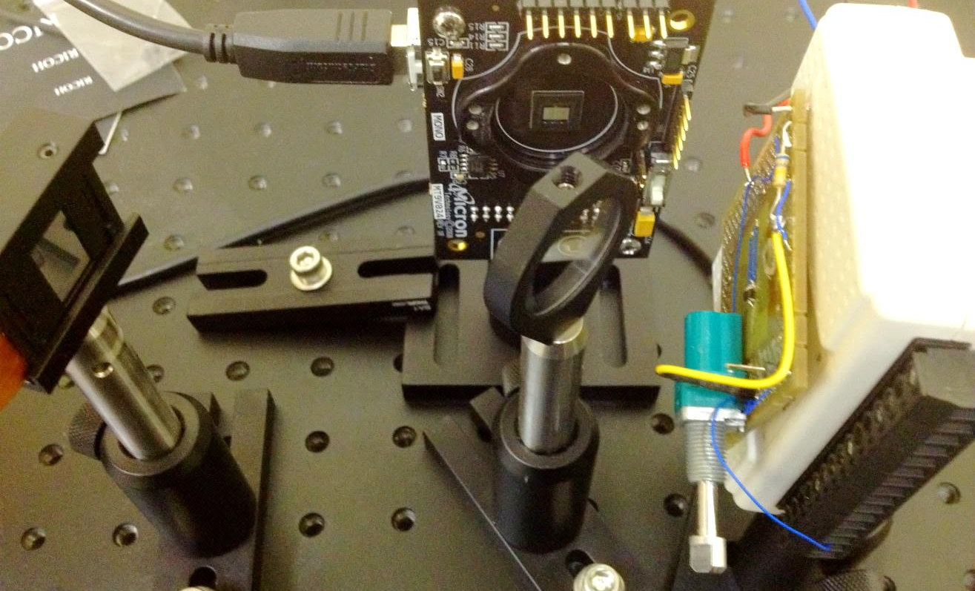
Results: Single Element Optical Processing
Target Response
Non-target Response
DSD
230.7±11.7mV
DSD
472.9±11.5mV
Target Hologram
2D imager
Distribution Sensitive
Detector (DSD)
Spatial Light
Modulator (SLM)
Target
Notes:
Lens TH

Slide 10
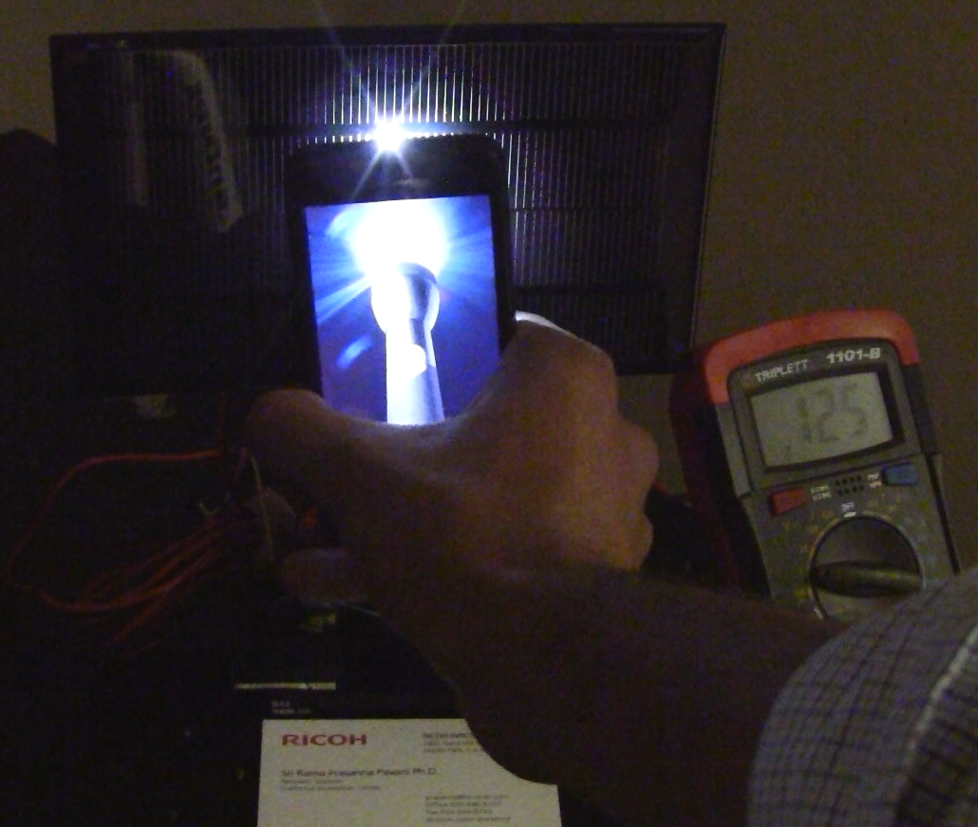
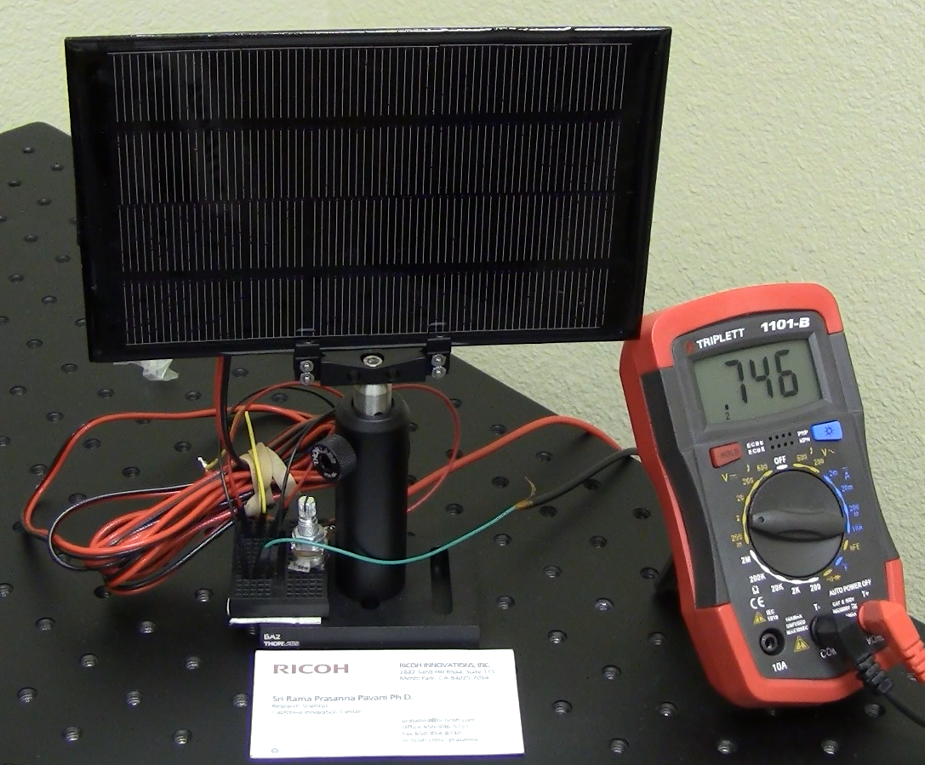
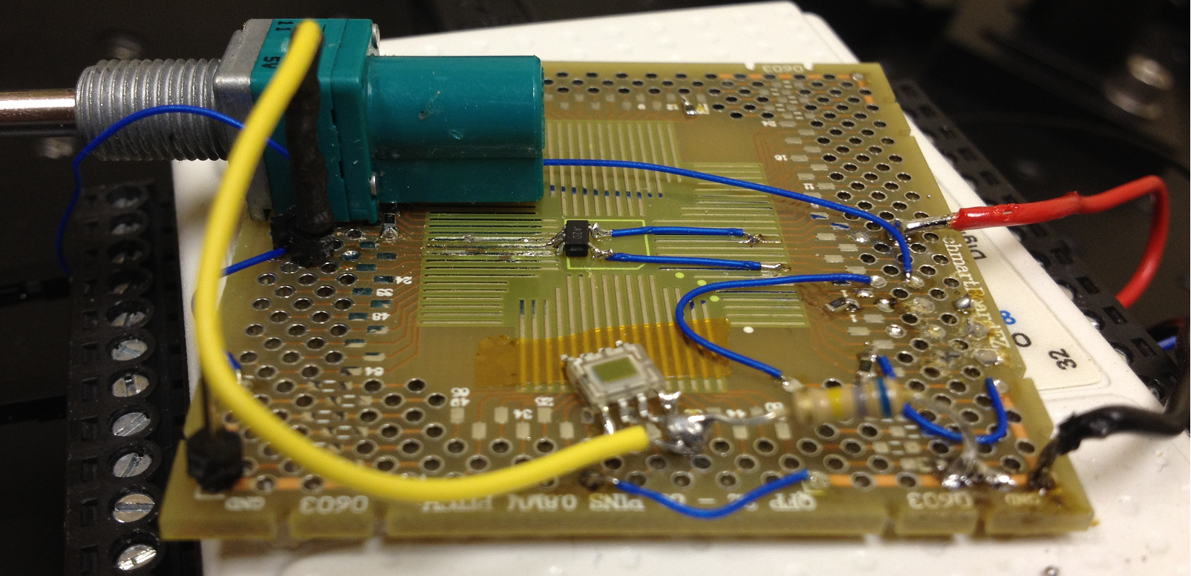
Results: Distribution Sensitive Detector
Load: 4KΩ
DSD output (Volts)
Source distance (cm)
Fluorescent lamp flicker

Slide 11
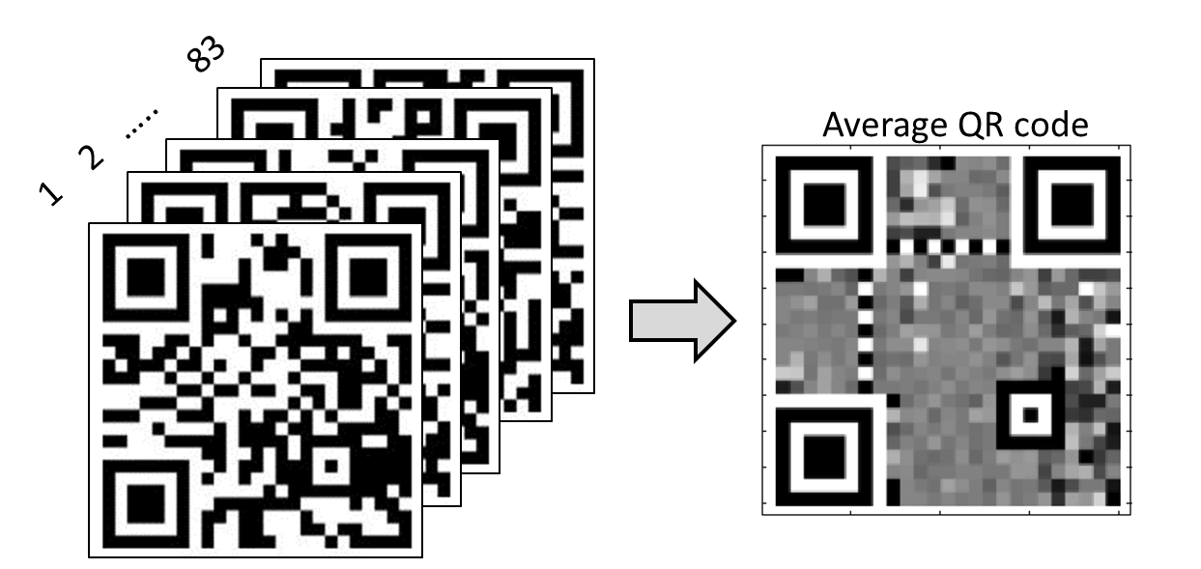
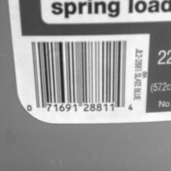
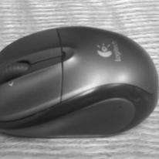
QR Code Detection (simulation)
Detection model: $c= \left[1 −n\sum_{x}{\sum_{y}{{\left[i\left(x,y\right)−f(x,y)\right]}^{2}}}\right]$
(Normalized voltage response)
Counts
QR code targets have c values between 0 - 0.15
Fisher linear discriminant based classification

Slide 12
Conclusion
HoloCam: new target detector
Target Hologram
Distribution Sensitive Detector
Low-power and high speed
Distribution Sensitive Detection is a new sensing paradigm
Single element optical processing allows for compact systems
Distribution Sensitive Detector (DSD)
Target
Hologram
Target
$$h(t)$$
$$a(t)$$
Ambient-light Detector
Notes:
- Emphasize constant monitoring after first bullet (Always on) detector

