Slide 1
A COSI Career
Prasanna Pavani

Slide 2
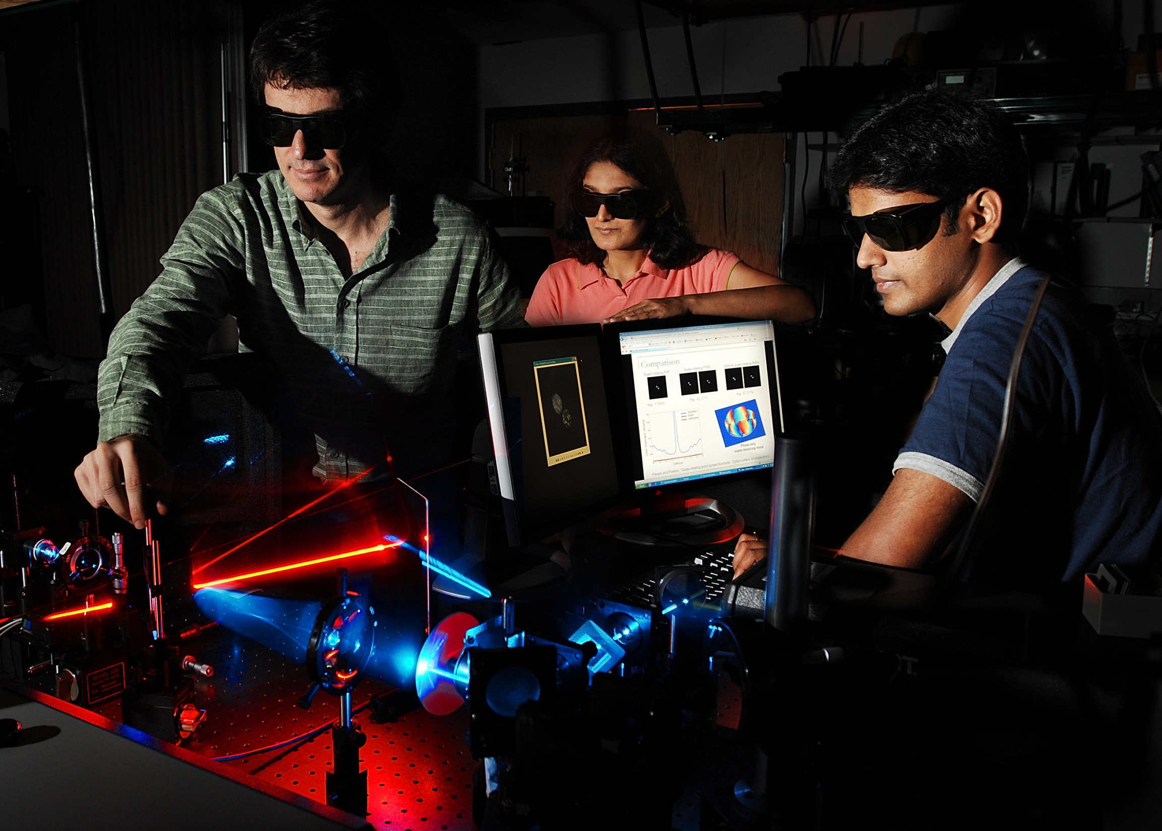
PhD, Colorado (2005 - 2009)

Slide 3
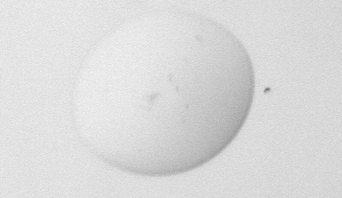
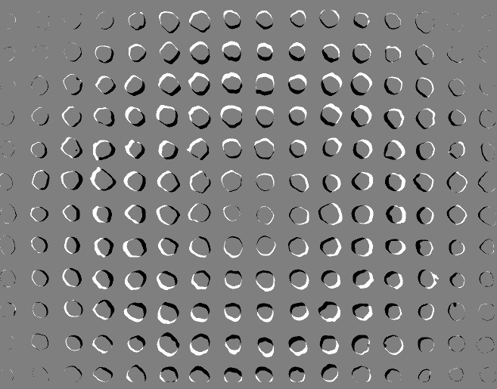
Transparent Object
Structured Illumination
Imaged phase objects!
Applied Optics 47, 15 (2008)

Slide 4
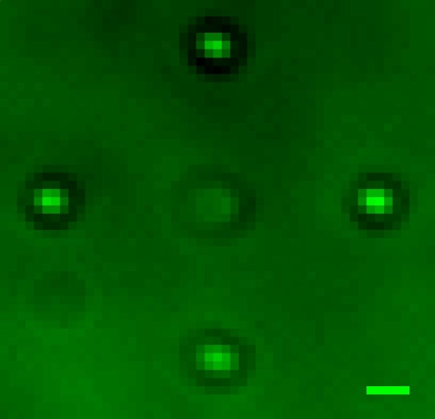
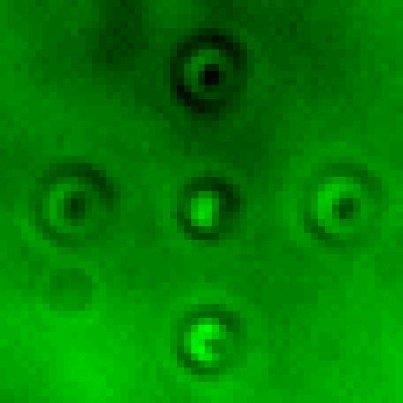
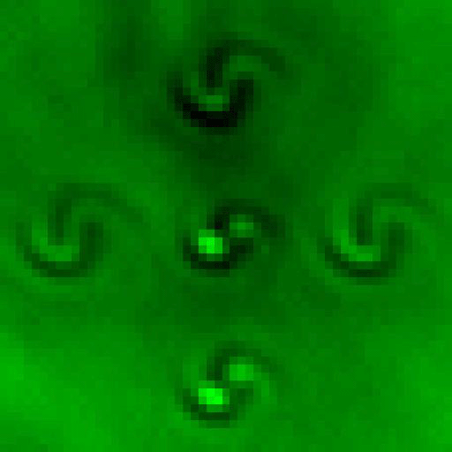
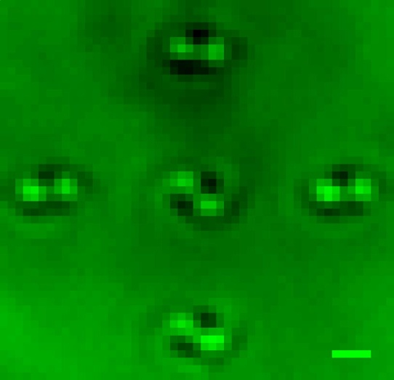
Standard PSF
Double-helix PSF
1μm
1μm
3D Nano-localization!
Opt. Exp. 16, 3484 (2008)
Opt. Exp. 16, 22048 (2008)
App. Phys. Lett. 95, 021103 (2009)

Slide 5
1μm
Detected single molecules!
PNAS 106, 2995 (2009)

Slide 6
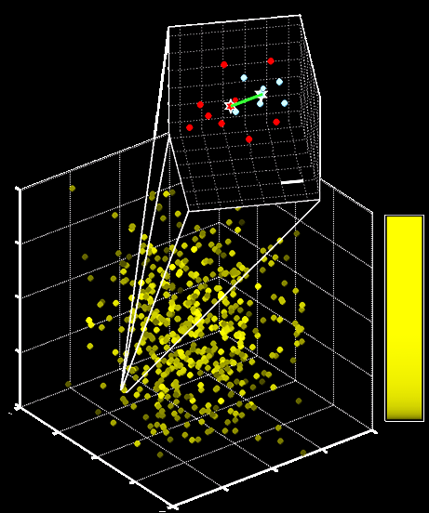
20nm
Photons
Broke 3D diffraction limit!
PNAS 106, 2995 (2009)

Slide 7
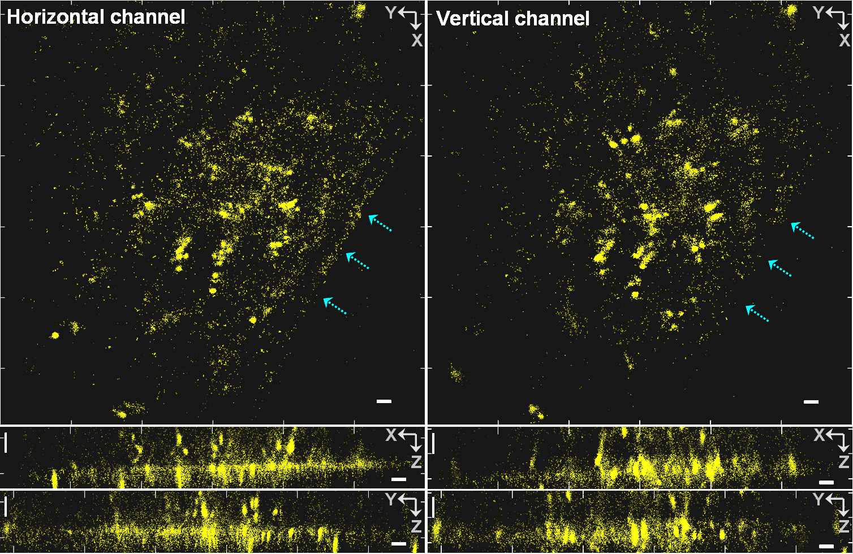
Super-resolved biological cells!
Opt. Exp. 22, 19644 (2009)

Slide 8
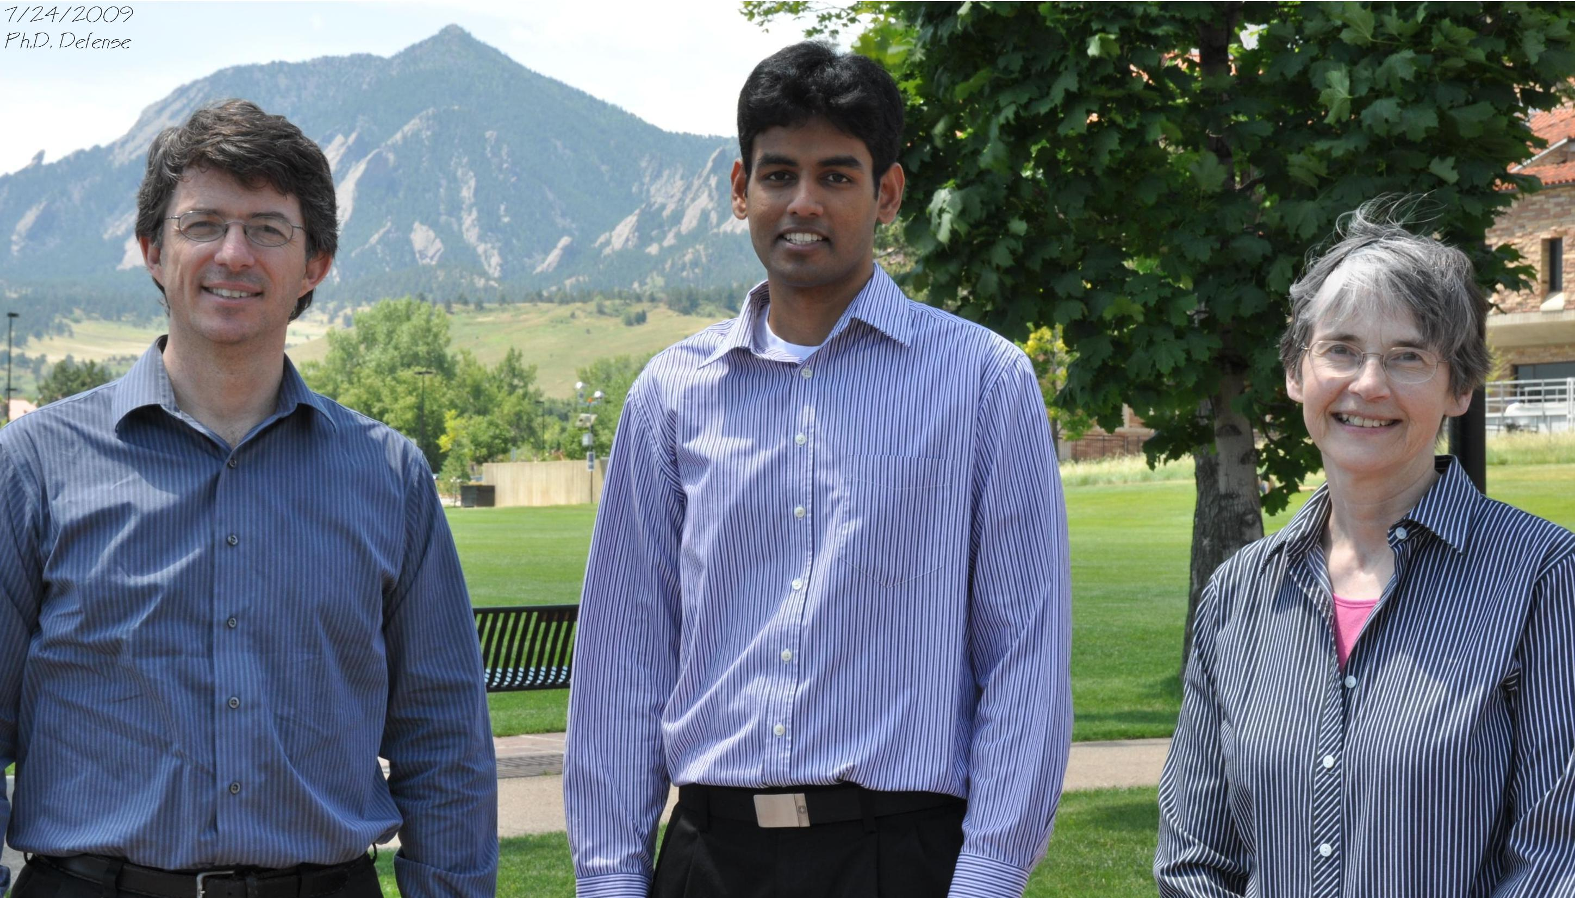
PhD defense day
Notes:
Better pic?

Slide 9
PhD isn't just about THESIS
Courses
Conferences
Collaborations
Internships
Seminars
Networking
What after PhD?

Slide 10
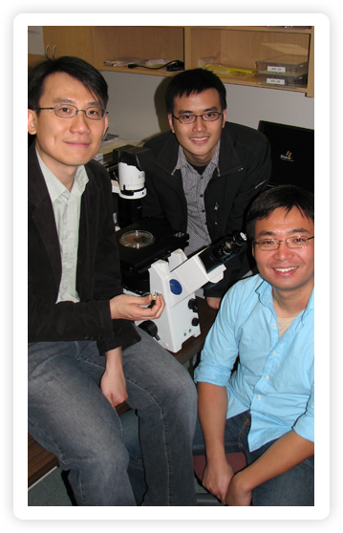
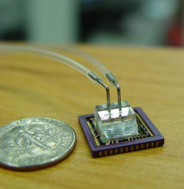
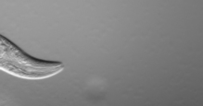
Caltech
Optofluidic microscope

Slide 11
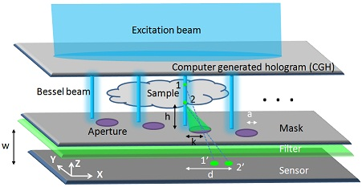
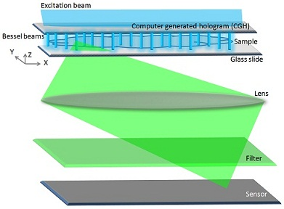
Postdoc, Caltech
Portable 3D, WF, EDOF, HR microscopes
US Patent 20110205339
US Patent 20110205352

Slide 12
http://www.someecards.com/graduation-cards/i-admire-your-relentless-drive

Slide 13
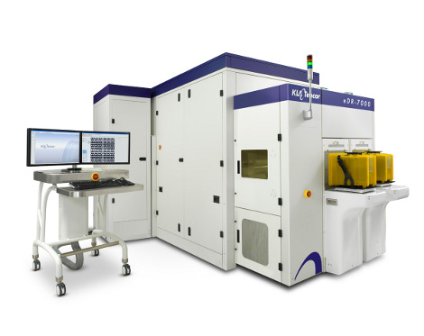
KLA-Tencor Corporation
http://semimd.com/wp-content/uploads/2011/08/KT_eDR470.jpg
Semiconductor wafer inspection

Slide 14
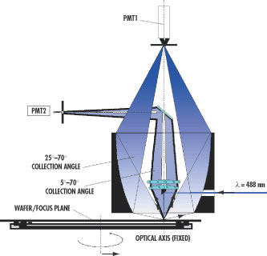
Research Scientist, KLA-Tencor
Find 20nm defects
on 200mm wafers
in 60 seconds
http://www.micromagazine.com/archive/01/01/williams.html

Slide 15
Ricoh
Production Printers

Slide 16
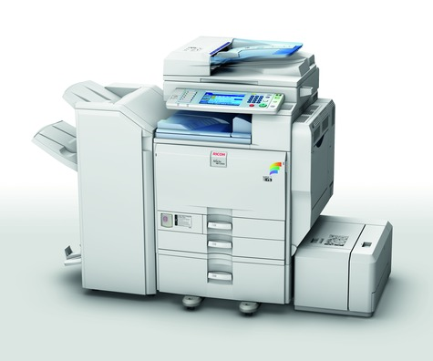
Ricoh
Multifunction Printers

Slide 17
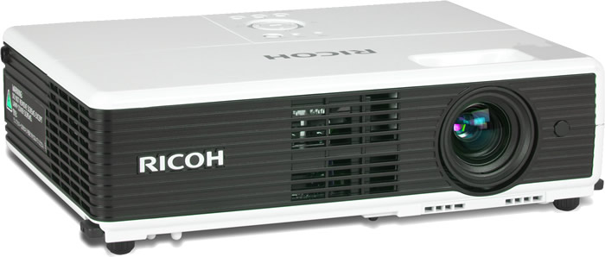
Ricoh
Projectors

Slide 18
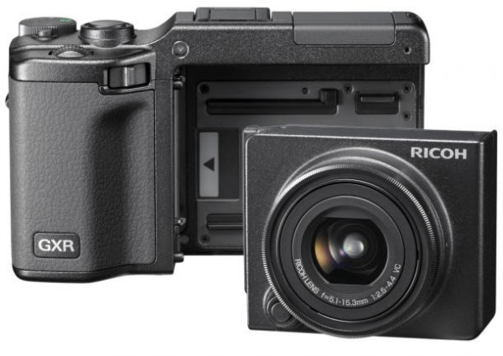
Ricoh
Cameras

Slide 19
E Ink Tablet

Slide 20
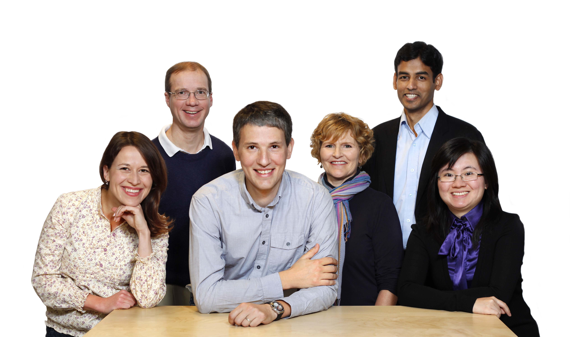
Ricoh Innovations

Slide 21
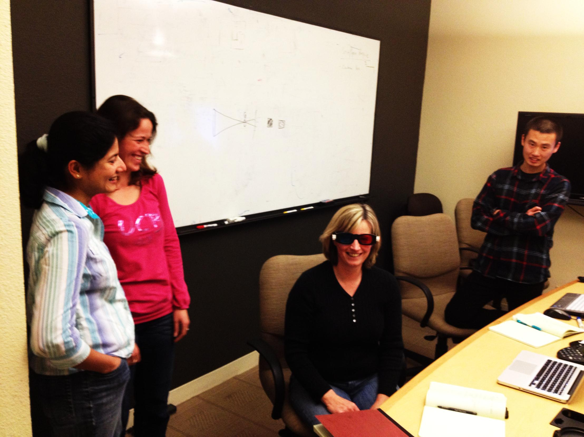
Computational Optics
& Visual Processing

Slide 22
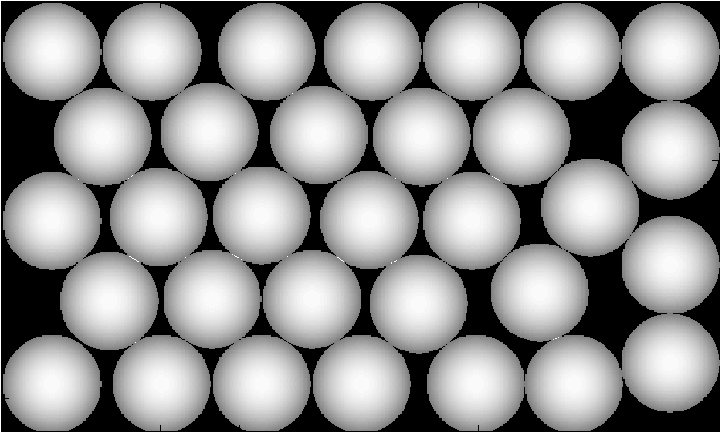
Advisory Research Scientist Ricoh Innovations
CMOS sensor
`
Lens
CMOS sensor
Lens
Optics
Multi-aperture Imagers
COSI, JTuD4 (2011)

Slide 23
A COSI Career
Prasanna Pavani

